Slide 1
Trouble with the (p-)curve
Questionable Research Practices, Replication and Publishing in Psychology

Slide 2
September’s colloquium
DSM-V and its controversies.
Parallel crises?
Our research literatures are likely to contain:
(a) inconsistencies
(b) falsehoods
What are the problematic issues?
What changes have been recommended?
Psychiatry | Clinical and Psychological Science
Crisis of confidence | Crisis of confidence
Questionable diagnostic practices | Questionable research (and publication) practices
Issues have been around for years | Issues have been around for years

Slide 3
A brief reminder of research outcomes
Population Sample | X exerts an effect on Y | X does not exert an effect on Y
X exerts an effect on Y | True positive | False positive (Type I error)
X does not exert an effect on Y | False negative (Type II error) | True negative
By convention, the probability of a false positive is supposed to be fixed at 5%. We require p < .05 to claim a statistically significant effect.
By (a far less well adhered to) convention, the probability of a false negative is supposed to be fixed at 20%. Acceptable statistical power is .8, meaning there is an 80% chance to find an effect, given it exists.

Slide 4
What are the possible outcomes of research?
What has recently (re-)emerged is that practices in psychology (some rare, others fairly common) alter these probabilities, meaning that the rate of false positives and of false negatives is likely to be significantly higher.
Fraud – obviously increases the rate of false positives (people don’t usually make up negatives!)
Questionable Research Practices (p-hacking) – less obviously, but no doubt more frequently, increase the rate of false positives.
Chronically under-powered studies – increase the rate of false negatives.

Slide 5
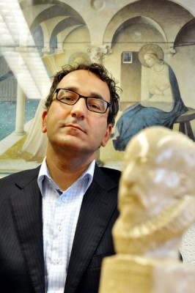
Cases of fraud
Diederik Stapel
Award-winning social psychologist.
137 published papers.
54 retracted to date.
Altered or simply made up data.
Brought down from within by his own students, to whom he had provided identical made-up datasets.
A number of his publications have data that are extremely odd.

Slide 6
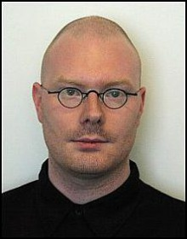
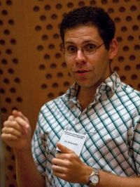
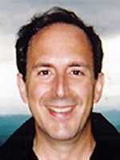
Cases of fraud
Less widely-known cases.
Dirk Smeesters and Lawrence Sanna
27 and 30 papers.
4 and 8 retracted to date.
Altered or simply made up data.
Brought down from without by Uri Simonsohn.
Suspicious patterns in published data, confirmed by examination of raw data.

Slide 7
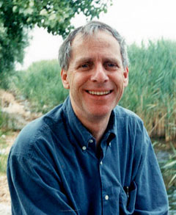
Detecting fraud by examining published and raw data
Simonsohn (2013)
To undetectably fabricate data is difficult. It requires:
A good understanding of the phenomenon being studied (What do the distributions of data tend to look like? Which variables correlate and by how much?)
A good understanding of how sampling error should affect the data (How much variation should we expect to see in the data?)

Slide 8
Detecting fraud by examining published and raw data
Just as human’s attempts to create randomness don’t really look like true randomness…
H T H T H H T T H T
H H H H H H T H T T
So too, human’s attempts to create data don’t really look like true data.

Slide 9
Detecting fraud by examining published and raw data
Simonsohn (2013)
Means (and sds) that were predicted to be similar were exceedingly similar, even with small numbers of participants (and very dissimilar manipulations).
In both cases, multiple highly-unlikely patterns were found, in multiple papers.
Comparison papers by others did not show the same patterns.

Slide 10
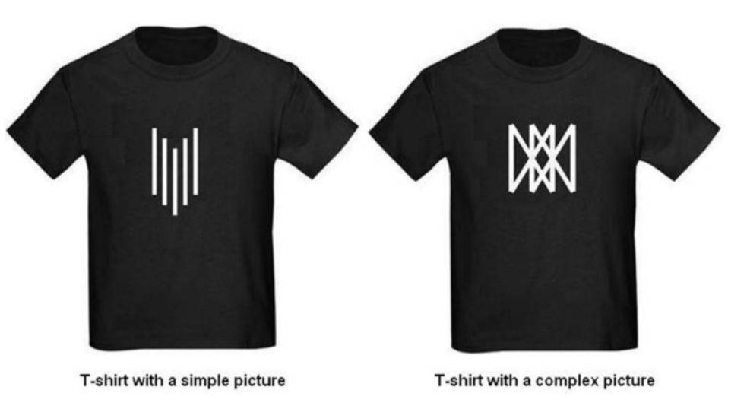
Detecting fraud by examining published and raw data
Typically, at least 50% of samples asked for their “willingness to pay” for things, generate numbers that are multiples of 5 (e.g. $5, $10, $15). Not so in Smeesters’ data.
In Smeesters’ data, only approximately 20% of data were multiples of 5.

Slide 11
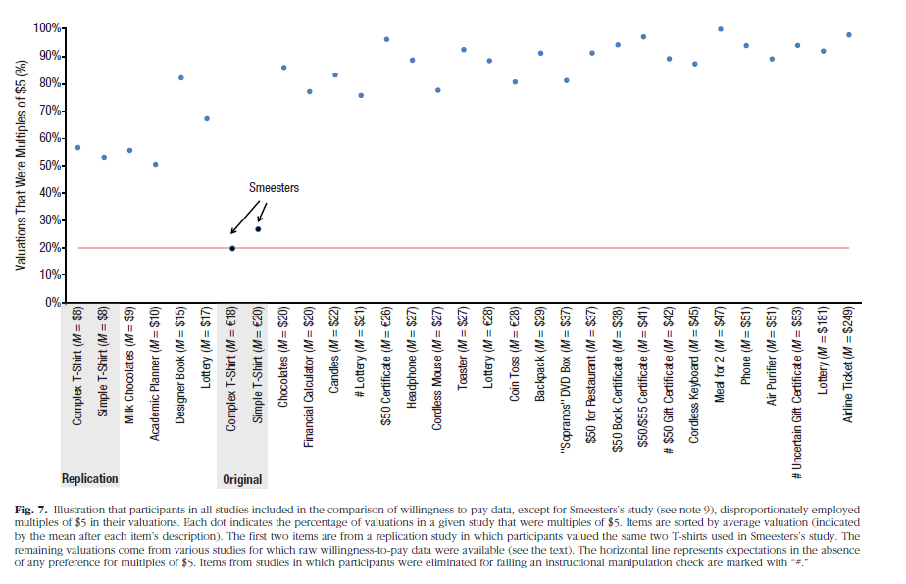
Detecting fraud by examining published and raw data

Slide 12
Fraud will be a lot harder to get away with if data are routinely archived
Simonsohn’s paper is called “Just post it”.
Fraud in these cases could not have been confirmed without access to the data.
Existing guidelines (e.g. Section 8.14 of the APA’s Ethical Principles of Psychologists and Code of Conduct) are inadequate.
Wicherts et al. (2006; 2011)
75% of a sample of psychologists refused to share their data when asked.
Those who refused were more likely than those who agreed to have errors in their published statistics. In other words their published t, F, or χ² statistics were inconsistent with the p values reported in the papers.

Slide 13
Data sharing
Perhaps journals, universities and granting agencies ought to start mandatory centralised data storage.
Are there any impediments to this?
Protection of participants’ anonymity
But there are ways to make data anonymous and many (most?) datasets already are anonymous
Researchers may want to conduct additional analyses
Perhaps allow such researchers a period of time before data are made available?
Involve the original researchers in the re-analysis.
Data sharing is coming. Some journals are strongly encouraging (e.g. Journal of Research in Personality) and others are now requiring (e.g. Judgment and Decision Making) that data files are submitted for accepted articles.

Slide 14
Recommendations
(1) Get ready to share your data!

Slide 15
Questionable Research Practices
Recently, attention has been focused on a series of so-called QRPs, a.k.a. researcher degrees of freedom.
Brought into focus by Daryl Bem’s 9-study Journal of Personality and Social Psychology paper which purported to show evidence for Psi phenomena.
JPSP’s editors defended its publication. The paper passed “stringent peer review” and meets our current standards of evidence.
The paper presents us with a dilemma. Either,
Psi phenomena are real, or
There is something wrong with our current standards of evidence.

Slide 16
Questionable Research Practices
Simmons, Nelson & Simonsohn (2011)
In the course of a typical study, researchers have to make many decisions that may not have immediately obvious answers:
How many participants should I test?
Should any participants be excluded from the dataset?
If there are a variety of potential DVs, which are the right ones for me to use?
Which are the important conditions (levels of the IV) to compare?
The ambiguity in these “researcher degrees of freedom” leave room for self-serving biases to affect decisions. We might make these decisions after examining their effect on the p-value.

Slide 17
Questionable Research Practices
p-hacking: Analysing your data multiple ways and selectively reporting only those that result in p < .05.
Simmons et al. generated random samples from the same underlying distributions.
(1) Assessing more than one Dependent Variable (DV), but reporting only those on which significant effects are obtained.
Approximately doubles the false positive rate (from 5% to 9.5%), in essence because it gives you two chances to find an effect. It’s exact effect depends on the correlation between the two DVs (if they do not correlate at all, you have two independent chances).
How prevalent is it?
John, Loewenstein and Prelec (2012) surveyed over 2000 U.S.-based psychologists.
66% of researchers admit to doing this.

Slide 18
Questionable Research Practices
(2) Assessing more than two conditions (and leaving out conditions that are not significantly different).
E.g. Testing “high”, “medium” and “low” conditions and reporting only the results of a “high” versus “medium” comparison.
Again, gives you more than one chance to find an effect. Increases the false positive rate to 12.6%.
How prevalent is it?
27% of researchers admit to doing this (John et al., 2012).
Again, in both of these cases, the problem is not that we allowed ourselves multiple tests of the hypothesis. It is in not reporting these tests, and hence not having to adjust the family-wise alpha.

Slide 19
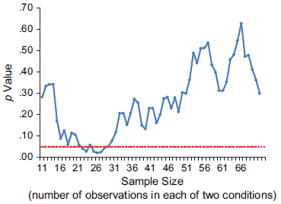
Questionable Research Practices
(3) Collecting the planned amount of data, analyzing the results, then adding additional participants and re-analyzing the results, stopping when significance is found.
How prevalent is it?
70% of researchers admit to deciding to continue, or to stop, collecting data based on looking at the interim results (John et al., 2012).
Even when the underlying distributions are identical, sampling can result in groups that test statistics indicate are statistically different (especially in small samples).

Slide 20
The worst case scenario
Simmons et al. (2011) assessed the impact of various combinations of these factors, and an additional one (recording a variable such as gender and then choosing to either control for its influence or not, or looking for an interaction with it or not, based on its effect on the p-value).
Doing all these things in combination leads to a massive increase in the chance of obtaining a false positive result. Instead of 5%, the false positive rate becomes 61%!
All of these practices corrupt the logic of the p-value, meaning that it provides far less protection against the likelihood of a false positive result.

Slide 21
What other questionable research practices will psychologists admit to?
Misreporting p-values (e.g. reporting p = .054 as p < .05).
23% of researchers admit to this (John et al., 2012).
Deciding whether or not to exclude data from some participants after looking at the impact on the results.
50% of researchers admit to this (John et al., 2012).
There is considerable flexibility in deciding whose data are (in)appropriate to include. For instance, there are almost as many decision rules regarding outliers in RT data as there are researchers.
Both of these practices also undoubtedly increase the false positive rate.

Slide 22
Are these practices ever justifiable?
Yes, in the context of exploratory research.
We may not know which variables or conditions will demonstrate an effect, or which participants will be affected by the manipulation.
However, if we test many of those conditions and variables and find effects in only some circumstances (e.g. in a subset of participants, in a subset of conditions, on a subset of DVs, after controlling for one – of several – co-variates) we have allowed ourselves many chances to find an effect.
We should acknowledge that fact, both to reviewers and to ourselves!

Slide 23
Exploratory versus confirmatory research
However, many researchers admit to:
Conducting many studies and selectively reporting only those that “worked”.
50% of researchers (John et al., 2012).
HARKing – Hypothesizing After the Results are Known (Kerr, 1998). Reporting unexpected findings as having been predicted from the start.
35% of researchers (John et al., 2012).
In other words, many researchers admit to misrepresenting exploratory research as predicted from the outset.

Slide 24
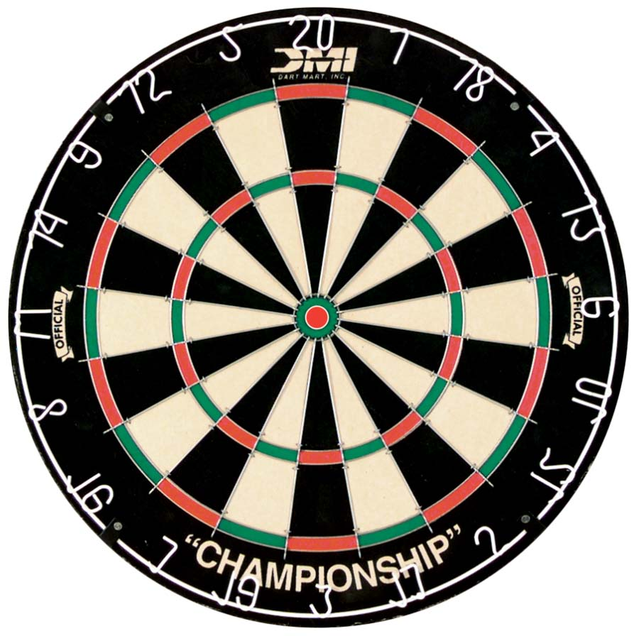
Exploratory versus confirmatory research
A dart-throwing analogy.
The logic of the p < .05 assumes that I predicted which area of the board I would hit before I threw the dart.
Because, if really I was throwing at random, there’s only a 5% chance I would hit that area of the board

Slide 25
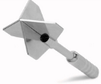
Exploratory versus confirmatory research
If I allowed myself many chances to hit the 20, my chance of hitting it by accident is obviously more than 5%.
Perhaps I threw darts I excluded from my report:
The wrong kind of dart
I had my left foot forward
I thought they were outliers (or weren’t representative)
Perhaps I also controlled for a covariate (beer intake)

Slide 26
Exploratory versus confirmatory research
The present situation in psychology is much like you (the reviewer, or the journal reader) seeing the dart already in the 20 and me (the study author) telling you that I predicted I could hit it.
I may not be telling you about all the darts
I may have concocted a plausible story about why this was the only dart that really mattered (even though I only came up with this story after I threw all the darts).

Slide 27
Exploratory versus confirmatory research
My story may seem reasonable.
However, I must be careful because I am strongly motivated to hit the 20 (to get p < .05)
If I really believe these things, then I need to directly replicate my throw, using the same dart, under the exact same conditions.

Slide 28
Exploratory versus confirmatory research
In other words, in order to believe in my ability, you would quite rightly demand that I throw another dart and that I again hit the 20.
You should demand I throw the same type of dart, with the same foot forward, and that I adjust for my beer intake.

Slide 29
Exploratory versus confirmatory research
So, many practices have a place in exploratory research.
However, we should be aware that we have usually given ourselves many chances to find an effect in exploratory research (we may have thrown many darts, or thrown one and then HARKed about what we would hit).
In both cases, the correct thing to do is to follow this up by throwing another dart under exactly the same conditions as we threw the first one. (A direct replication.)
Conceptual replications are not good enough.

Slide 30
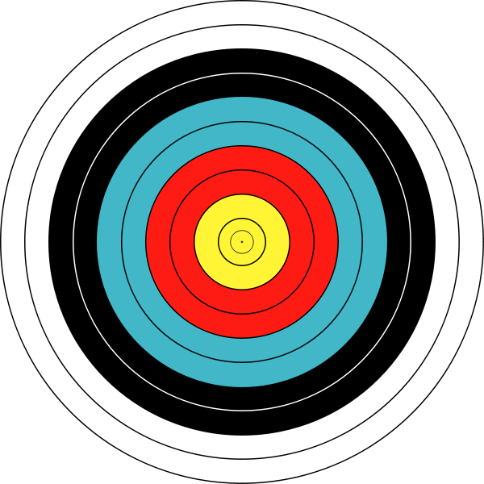
Problems with conceptual replication
What if instead of throwing another dart, I told you I’d prove my aim in a different set of circumstances.
Let’s suppose I fail to hit an equivalently-sized area of the archery target.
This does not undermine my claim to be a good dart thrower.

Slide 31
Problems with conceptual replication
In other words, a failure of conceptual replication can be explained away. It does not invalidate the original result.
It does not provide for falsification.
But, let’s suppose I do conceptually replicate my result, hitting the target.

Slide 32
Problems with conceptual replication
However, in these new circumstances, I may allow myself just as much flexibility in deciding which arrow was the fairest test as I did with the darts.
The wrong type of bow
A completely different, incorrect stance
Maybe this time I controlled for the wind

Slide 33
Recommendations
Get ready to share your data.
Don’t p-hack. If you don’t p-hack, explicitly say you don’t p-hack.
If you conducted an exploratory study and took advantage of researcher degrees of freedom to obtain significance, perform a direct replication.

Slide 34
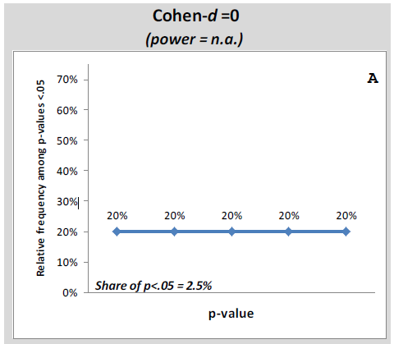
Skepticism is growing
Simonsohn, Nelson & Simmons (in press).
The p-curve.
All values of p below .05 are publishable. By examining the distribution of a related set of p-values (the p-curve) we can determine the likelihood that a set of findings have been p-hacked.

Slide 35
Skepticism is growing
For effects that exist, the distribution of p-values below .05 will be right-skewed.
The extent of the skew depends on the effect size and the sample size.
However, even with a small (real) effect and 20 participants per cell, the distribution is right-skewed.

Slide 36
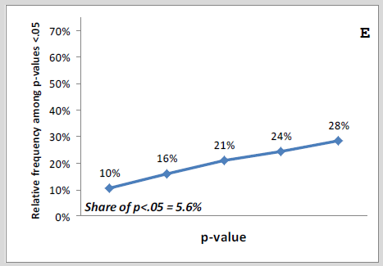
Skepticism is growing
However, consider the case where a researcher is chasing an effect that does not really exist by assessing the p-value after every 5 participants.
This researcher will stop as soon as the p-value falls below .05. Thus, in such a body of work, there will be many p-values just below .05.

Slide 37
Skepticism is growing
Post-publication peer review:
Some electronic journals allow post-publication commentary on papers.
Other researchers are publishing post-publication peer reviews on their websites.
Already, people are pointing to anomalies in statistical reporting that weren’t spotted during peer review (e.g. test statistics that don’t match reported means and sds, reported ns that are different between abstract and method sections) as well as commenting on the likelihood of QRPs, demand characteristics and experimenter effects.

Slide 38
Skepticism is growing
In this climate, what can we do as researchers to enhance the credibility of our research?
“If you are not p-hacking and you know it, clap your hands.” (Simmons et al., 2012)
Decide on a termination rule for data collection and stick to it.
Base your termination rule on a power analysis, which will tell you what size sample you need to stand a good chance of finding an effect.
Report all variables and all conditions from a study, even ones that did not ‘work’.
If observations are eliminated, or analyses done with covariates, also report the results including those observations and excluding those covariates.
Don’t HARK! Report exploratory analyses as such.

Slide 39
Skepticism is growing
In this climate, what can we do as researchers to enhance the credibility of our research?
“If you are not p-hacking and you know it, clap your hands.” (Simmons et al., 2012)
“We report how we determined our sample size, all data exclusions (if any), all manipulations, and all measures in the study.”

Slide 40
What changes might be occurring?
If something is worth doing, it’s worth doing twice.
If you took advantage of RDF to get a result, replicate.
If you suspect the same about key findings, replicate.
To date, journals have followed a policy of only publishing novel work.
“We publish original empirical results”
However, some journals have now created options for submitting replication efforts.
Both Attention, Perception and Psychophysics and The Journal of Research in Personality now have article formats that are specifically for replication efforts of “theoretically important” findings.

Slide 41
What changes might be occurring?
Perspectives on Psychological Science has created the option for “Registered Replication Reports”:
“Authors submit a detailed description of the method and analysis plan. The submitted plan is then sent to the author(s) of the replicated study for review. Because the proposal review occurs before data collection, reviewers have an incentive to make sure that the planned replication conforms to the methods of the original study. Consequently, the review process is more constructive than combative.”
Results are published regardless of outcome.

Slide 42
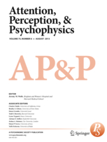
What changes might be occurring?
Pre-registration.
Registering your hypotheses, research methods (ns, all IVs, covariates, DVs, etc.) and plan for data analysis, before you conduct the study.
APP has a “registered reports” section, (as does Cortex).
A two-stage review
Submit your methodology
The resulting study is published, regardless of outcome, if you stick to proposed methodology

Slide 43
What changes might be occurring?
Pre-registration.
The World Medical Association’s latest revision to the Declaration of the Helsinki Ethical Principles for Medical Research Involving Human Subjects.
“35. Every research study involving human subjects must be registered in a publicly accessible database before recruitment of the first subject.”
May be expanded to cover non-medical research.

Slide 44
Recommendations
Get ready to share your data.
Don’t p-hack. Say you don’t p-hack.
If you conducted an exploratory study and took advantage of researcher degrees of freedom to obtain significance, perform a direct replication.
Consider posting supplementary materials relating to your study online (data, materials, videos of procedures; Nosek, Spies & Motyl, 2012).
If skeptical of research findings, p-curve them. Conduct (now publishable) replication attempts.

Slide 45
What about the false negatives?
Much of the recent attention has been focused on the problem of false positives.
However, we are likely to have many false negatives in psychology as well.
Psychology studies are chronically under-powered.
We have a puzzle.
The majority of effects in (social) psychology are small-to-medium (Richard, Bond & Stokes-Zoota, 2003).
Yet sample sizes are routinely only large enough to stand a good chance of finding large effects.
Why are psychologists such bad gamblers?

Slide 46
Low power and Type II error
Maxwell (2004) – it is true that most studies are underpowered.
However, this is true only in the sense that tests of any specific hypothesis tend to lack adequate power.
However, the probability of obtaining a statistically significant result in a typical study could still be substantial because most studies test multiple hypotheses.
Multiple IVs, multiple interactions and covariates
Even if we correct for the resulting inflation of Type I error (by controlling the family-wise alpha), we increase the risk of Type II error.

Slide 47
Low power and Type II error
Consider a hypothetical three-group design in which all three population means are actually different.
In high-school, self-identified Goths score higher than Nerds, who score higher than Jocks.

Slide 48
Low power and Type II error
Consider a hypotheticial three-group design in which all three population means are actually different.
For a given sample size, our chance to find all of these effects (Goths > Nerds, Goths > Jocks, Nerds > Jocks) is smaller than our chance to find a single pre-specified effect (e.g. Goths > Jocks). That, in turn, is smaller than our chance to find any one of these three effects.
In other words, studies that are underpowered to find all effects, or to find a single pre-specified effect, may still have enough power to find one of the effects.
For publication, finding one significant effect is good enough!

Slide 49
Low power and Type II error
Suppose that we design a study investigating the influence of two IVs and their interaction.
Suppose that the two IVs actually exert a medium effect, as does their interaction.
Whatever our sample size, the chance of finding all of these effects is lower than the chance of finding a specific single effect. That in turn is lower than the chance of finding at least one of the effects (without pre-specifying which one).
 | Cell size
Type of power | n = 10 | n = 20 | n = 30 | n = 40
Any single pre-specified effect | .35 | .59 | .79 | .88
At least one effect | .71 | .93 | .99 | >.99
All effects | .04 | .21 | .47 | .69

Slide 50
Low power and Type II error
Let’s suppose you conduct one of these studies. In your study, you sample 80 people and your chance of finding at least one effect is 93%. You find that one of your IVs has a statistically significant main effect, and decide to publish it.
But, there’s a 79% chance you missed at least one effect that was actually there (the other main effect, or the interaction).
Someone else may run an exact replication, with the same sample size. In their study, they also stand a 93% chance to find an effect, but it won’t necessarily be the same one you found.
So, in the end, the literature will seem inconsistent, with different effects showing up in different studies (even though they are all real effects).

Slide 51
Low power and Type II error
Maxwell runs through the logic of this applied to multiple regression.
Suppose we investigate the influence of 5 predictors of depression in a high-school sample (academic, athletic, behavioural, and social competence, as well as appearance).
All actually exert true medium-sized effects, but are correlated with each other.
If we collect data from 20x the number of participants as predictors (100), we stand a 84% of finding one of the significant effects.
And a less than 1% chance of finding all of them!

Slide 52
Low power and Type II error
So, psychologists are not such bad gamblers after all.
Even though we underpower our studies in the sense that our chance to find pre-specified effects is low, we actually usually have a decent chance to find some type of effect in our data (assuming that we have chosen to investigate plausible predictors or IVs).
However, in underpowering our studies to find all potential effects that could be present, we virtually guarantee that we miss effects in our data.
The end result of this will be many Type II errors and a very inconsistent body of literature, with different studies showing different effects.
Lack of (statistical) power corrupts!

Slide 53
Recommendations
Get ready to share your data.
Don’t p-hack. Say you don’t p-hack.
If you conducted an exploratory study and took advantage of researcher degrees of freedom to obtain significance, perform a direct replication.
Consider posting supplementary materials relating to your study online (data, materials, videos of procedures; Nosek, Spies & Motyl, 2012).
If skeptical of research findings, p-curve them. Conduct (now publishable) replication attempts.
Power analyses. Assume a moderate or small effect and power studies accordingly!
Value a single highly-powered study more than multiple under-powered ones.

Slide 54
References
John, L.K., Loewenstein, G. & Prelec, D. (2012). Measuring the prevalence of questionable research practices with incentives for truth telling. Psychological Science, 23, 524-532.
Kerr, N.L. (1998). HARKing: Hypothesizing after the results are known. Personality and Social Psychology Review, 2, 196-217.
Maxwell, S.E. (2004). The persistence of underpowered studies in psychological research: Causes, consequences, and remedies. Psychological Methods, 9, 147-163.
Nosek, B.A., Spies, J.R. & Motyl, M. (2012). Scientific Utopia: II. Restructuring incentives and practices to promote truth over publishability. Perspectives on Psychological Science, 7, 615-631.

Slide 55
References
Richard, F.D., Bond, C.F. & Stokes-Zoota, J.J. (2003). One hundred years of social psychology quantitatively described. Review of General Psychology, 7, 331-363.
Simmons, J.P., Nelson, L.D. & Simonsohn, U. (2011). False-positive psychology: Undisclosed flexibility in data collection and analysis allows presenting anything as significant. Psychological Science, 22, 1359-1366.
Simmons, J.P., Nelson, L.D., Simonsohn, U. (2012). A 21 word solution. Available here: http://papers.ssrn.com/sol3/papers.cfm?abstract_id=2160588
Simonsohn, U. (2013). Just post it: The lesson from two cases of fabricates data detected by statistics alone. Psychological Science, 24, 1875-1888.

Slide 56
References
Simonsohn, U. , Nelson, L. & Simmons, J. (in press). P-curve: A key to the file drawer. Journal of Experimental Psychology: General.
This paper, along with other p-curve resources, is available here: http://www.p-curve.com/
See here for the reports into the Stapel fraud: https://www.commissielevelt.nl/
Wicherts, J.M., Borsboom, D., Kats, J. & Molenaar, D. (2006). The poor availability of psychological research data for reanalysis. American Psychologist, 61, 726-728.
Wicherts, J.M., Bakker, M. & Molenaar, D. (2011). Willingness to share research data is related to the strength of the evidence and the quality of reporting of statistical results. PLoS One, 6.

Slide 57
Related publications
More interesting reading that I didn’t reference, but that take a critical approach to research and publication practices:
Fiedler, K. (2011). Voodoo correlations are everywhere – not only in neuroscience. Perspectives on Psychological Science, 6, 163-171.
Giner-Sorolla, R. (2012). Science or art? How aesthetic standards grease the way through the publication bottleneck but undermine science. Perspectives on Psychological Science, 7, 562-571.
McGuire, W.J. (2013). An additional future for psychological science. Perspectives on Psychological Science, 8, 414-423.
Nosek, B.A. & Bar-Anan, Y. (2012). Scientific Utopia: I. Opening Scientific Communication. Psychological Inquiry, 23, 217-243.

